Slide 1
RURAL AFFORDABLE HOUSING ? WHY WHAT HOW ? A National Context and East Midlands Perspective
Presentation by:
Jo Lavis
Rural Housing Solutions
www.ruralhousingsolutions.co.uk

Slide 2
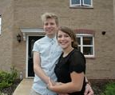
WHO LIVES IN AFFORDABLE HOUSING?
Housing Association
Housing Association
Owner-occupiers
Owner-occupiers
EVERYONE NEEDS SOMEWHERE THEY CAN CALL HOME
Owner-occupiers
Housing Association

Slide 3
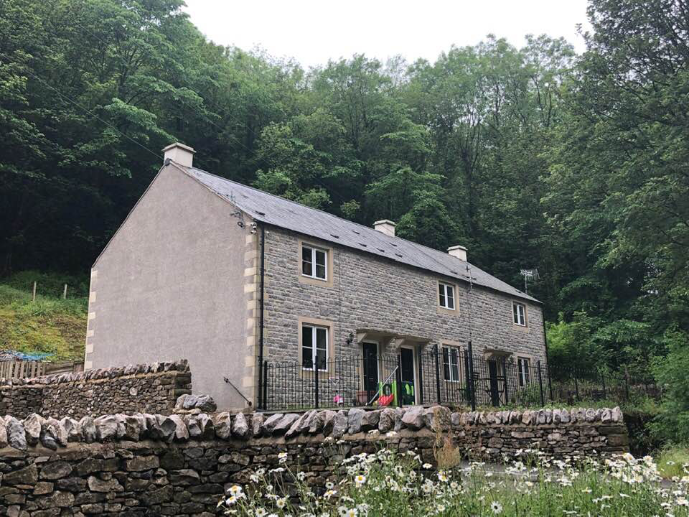
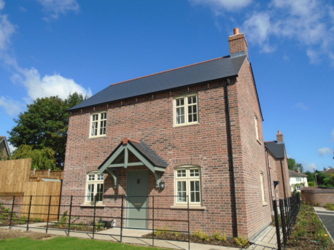
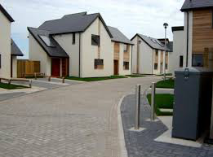
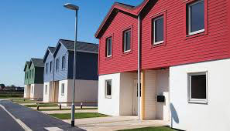
Which is the Housing Association development?
Peak District Rural HA
Acclaim HA
ALL
OF THEM!
Lincolnshire Rural HA
AND ALL IN THE
EAST MIDLANDS

Slide 4
What is it?
Affordability
What a person/household can pay on rent/mortgage costs
Sale
3.5 X annual income
Rent
33% of net income
Affordable/social rent
Discounted market sales
Starter Homes
Shared Ownership /Rent to Buy
Affordable housing
‘Housing for sale or rent for those whose needs are not met by the market’
Rural + perpetuity

Slide 5
1. Affordability threshold =
Rents or Purchase costs exceed 33% of median locally earned income
2. Relate this not to a ‘product’ but groups affected:
struggling renters
low income older households
struggling homeowners
frustrated first time buyers
https://static1.squarespace.com/static/5b9675fc1137a618f278542d/t/5cf55923f41ae70001170311/1559583017920/Defining+and+measuring+housing+affordability.pdf

Slide 6
Is there an affordability problem in rural East Midlands?
Housing stock
EM rural districts Social housing 11%
(England <3k pop. villages = 8%)
LQ price ratio 8.5:1
LQ private rents = 32%
of LQ income
Completions 2015 – 16
84% market
16% affordable
Approx 4% (259) of all completions were affordable in settlements <3k
2018 people on rural LA waiting lists = 17,820

Slide 7
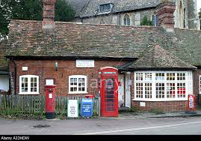
Why is affordable housing important?
Integral to sustainability of rural communities
Social support
Jobs
Services
Reduce carbon
Independence
“The countryside is not only about the landscape, but the communities within it.”
Elinor Goodman – Affordable Rural Housing Commission
“In many cases just a few well designed homes, kept in perpetuity for local people will make the difference to the sustainability of the community”
Lord Taylor – Living, Working Countryside

Slide 8
Key components of Providing Rural Affordable Housing
Finance
Perpetuity arrangements
Planning policy
Community engagement
& support
Deliverable site

Slide 9
Planning Routes for delivering rural affordable housing
Allocated sites in Local Plan Residual valuation drives land price
With affordable housing contribution
(part of 5 yr land supply ) Market return for landowner
Windfall site
With affordable housing contribution Residual valuation drives land price
Market return for landowner
Rural Exception site Value reflects that this is not a site
Primary function is to provide allocated for market development
Rural affordable housing

Slide 10
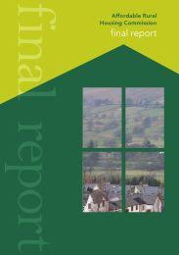
National Shortfall
Need = 7500 new AfH pa
Delivery 2017/18 = 4,595
WHY?
Lack of sites
Restrictive planning
Lack of funding
Local opposition
Weak political leadership
Lack of rural proofing

Slide 11
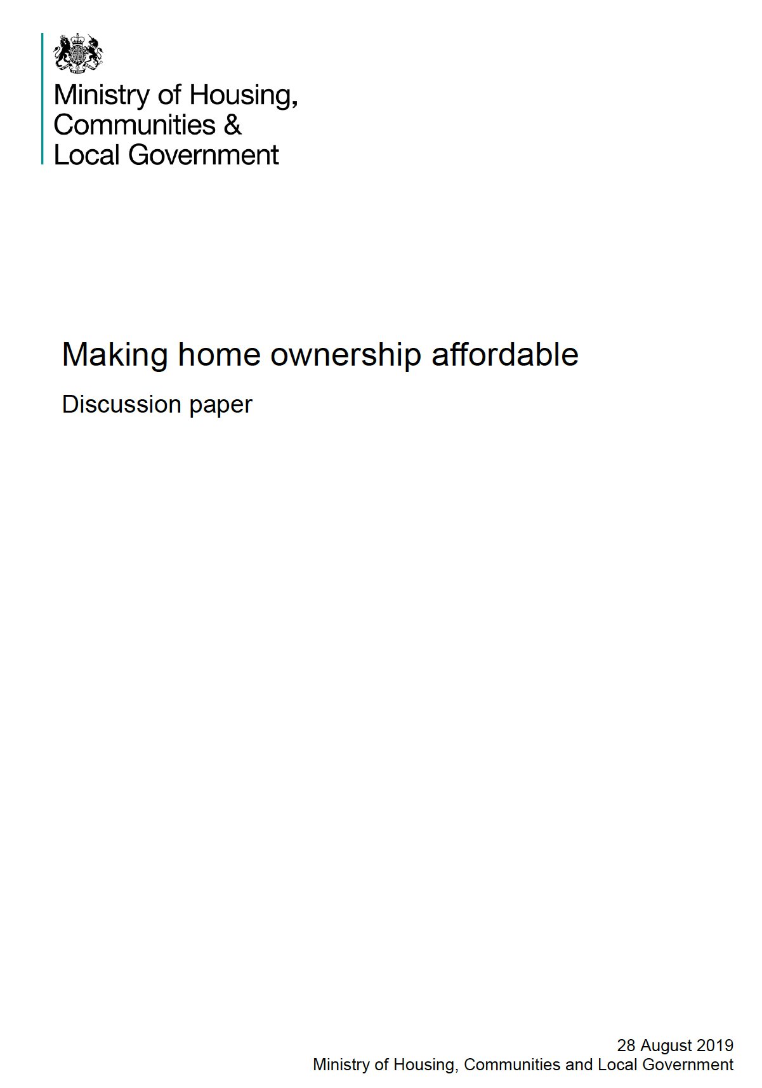
National Policy context

Slide 12
NPPF
RURAL HOUSING
Paragraph 77
Planning policies and decisions should be responsive to local circumstances and support housing developments that meet local needs.
Paragraph 78
To promote sustainable development in rural areas housing should be located where it will enhance or maintain the vitality of rural communities.
Planning policies should identify opportunities for villages to grow and thrive, particularly where this will support local services.
BUT

Slide 13
ALLOCATED SITES
No on-site contribution from sites <10 units
Limited designated rural areas where can take £ sum
ROLLING 5 YR LAND SUPPLY
‘Hope’ of future allocation of land
PRESUMPTION IN FAVOUR OF SUSTAINABLE DEVELOPMENT
RESULT
Land values rise and/or landowner does not release land for RES
NPPG ?
HOW?
Only NPPF policy route for rural affordable housing is RES
PLUS – does not deliver enough

Slide 14
Finance
BUT
Social rent funding not universal
CHF only until end 2019
No rural monitoring of spend
No rural requirement on Strategic Partners
64% of rural LAs are not eligible
Capital grant for social rent in areas where affordability a challenge
Community Housing Fund £163m
Longer term funding for Strategic Partners
Plus capital borrowing restrictions lifted for LAs building themselves

Slide 15
Housing Green Paper Perpetuity & Allocations
BUT
Rural not in pilot
No requirement for replacement in community of RTB sale
Ignores rural SO perpetuity protctions
Voluntary Right to Buy – rural ‘exemption’
Starter Home – Exemption for Rural Exception Sites
Consultation on RTB receipts to support replacement
New Shared Ownership model

Slide 16
Work some Miracles!
Know the key players and what they do
Support positive policies for rural affordable housing in your Local Plan
Get involved in a scheme in your village
Don’t wait
Engage as soon as you can
Miracle Court - Bakewell
Peak District Rural HA

Slide 17
AND THIS IS WHY…….

